Slide 1
EBGN645: Day 3

Slide 2
Notes
Need to be able to call ‘gams’ from the command prompt or terminal – can cover this at the end of class for those who need help (will need to borrow someone’s windows-based laptop)
You should also have installed the class GAMS license
No class on November 10-12 – depending on our progress, will record a lecture for those days
Paper under review at Joule

Slide 3
Proposal Notes
Proposal rubric sent
Mainly trying to get you to…
define your research question < this is the biggest one
think about what is possible for your project
see what else has been done by others
begin to gather data
think about your model setup
What is the objective?
What constraints are needed?

Slide 4
Questions
Can I get an overview of the current US energy landscape?
Why can’t I call GAMS from the command prompt/terminal?
Can you talk slower?

Slide 5
Question for you…
What sort of examples would you like to see in class?
In the past, have covered:
NG extraction in the face of pressure decline curves
Electricity dispatch (very simple)
Mining and resource extraction
Policies
ReEDS – ‘industrial-scale models’

Slide 6
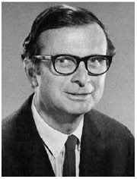
A short rant
The role of the modeler is to provide information
You should not make judgement or inject bias
You are entitled to your opinion… but do not let it enter the modeling
Very easy to spot after a bit of experience
Still not right, even if common
However, there are limits…
“And if our clients blow up the world, land us in starvation or totalitarianism, that is too bad, but we remained pure in heart to the last, didn't we?”
“However a systems problem is solved—by a planner, scientist, politician, antiplanner, or whomever—the solution is wrong, even dangerously wrong. There is bound to be deception in any approach to the system.”
- C West Churchman
‘Thought likes solutions, wisdom abhors them.’

Slide 7
Agenda
Practicing GAMS/GitHub
(Very) Simple examples
Common errors
Introducing time
(slightly) less simple example, introduction of conditionals
Last 15 minutes – helping figure out computer issues
Tools to introduce:
Conditionals via dollar signs
Restarts/saves
gdxmerge
gdxdiff
globals
Note: all AI images are intentionally hacky

Slide 8
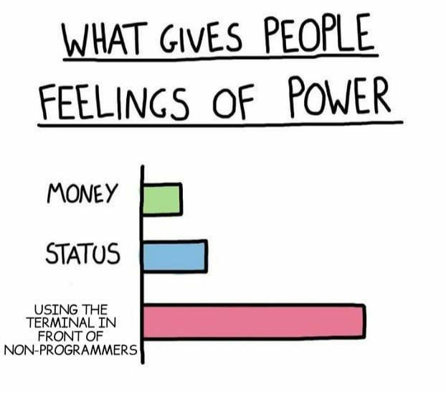
But first… a meme

Slide 9
Ripley’s restaurant – A very simple model
Ripley works 40 hours per week making hamburgers, hot dogs, and french fries. The net revenue and time to make for each of the items is in the table below.
What is Ripley’s profit-maximizing production choice?
Item | Revenue | Cost | Hours
Hamburger | 1.5 | 0.75 | 0.5
Hot dog | 0.75 | 0.1 | 0.2
French fries | 0.25 | 0.05 | 0.1

Slide 10
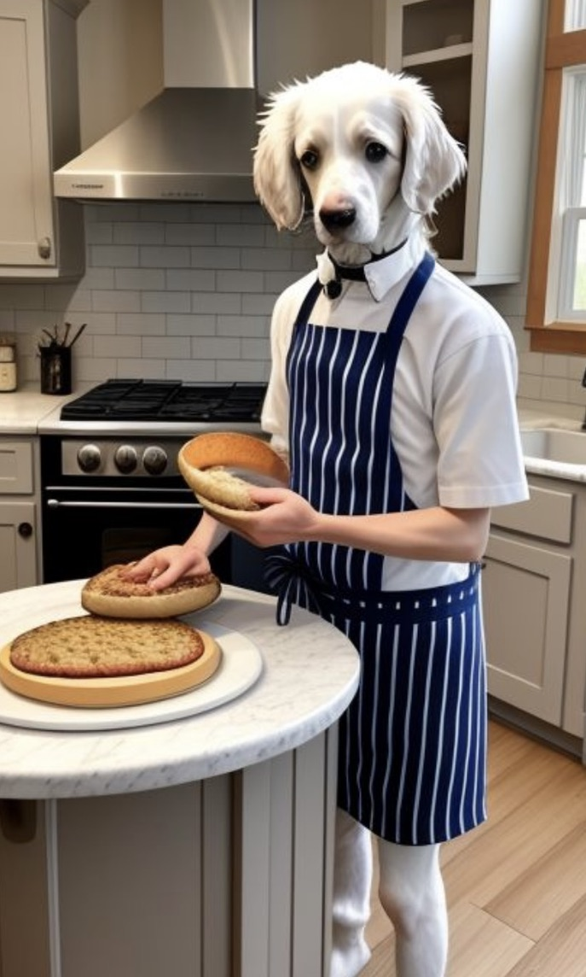
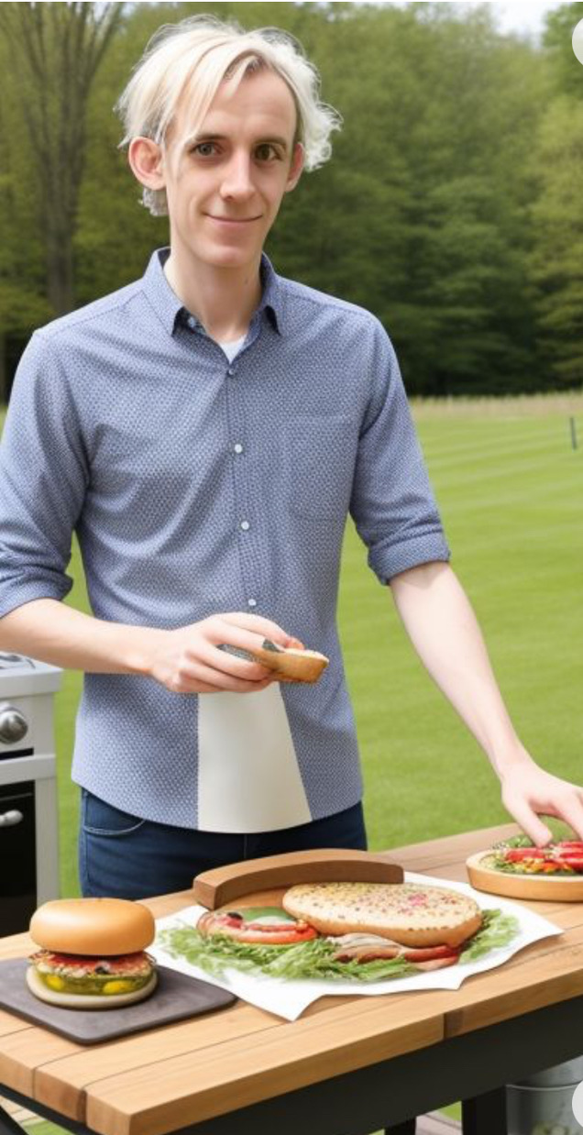
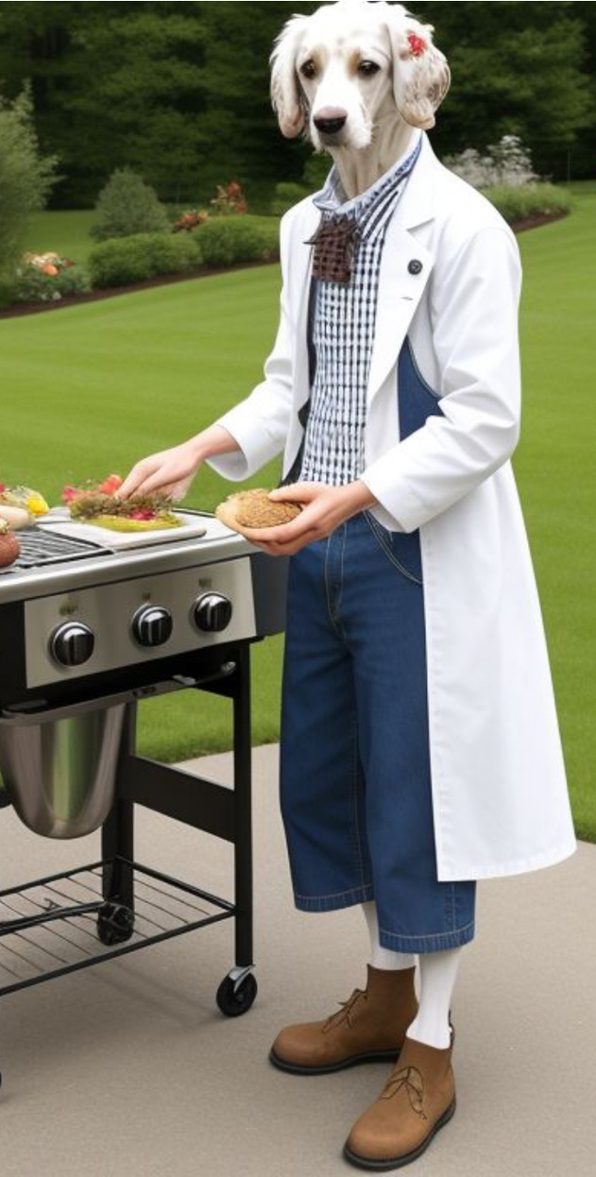
Ripley’s restaurant – visualized by (janky) AI

Slide 11
Writing a model
Always go in this order:
Sets/indices
Parameters
Variables
Objective function (when appropriate)
Constraints
See explanation/examples in INFORMS (Grievel et al.) or CCS papers
This is a requirement of any model for this course – homework/projects

Slide 12
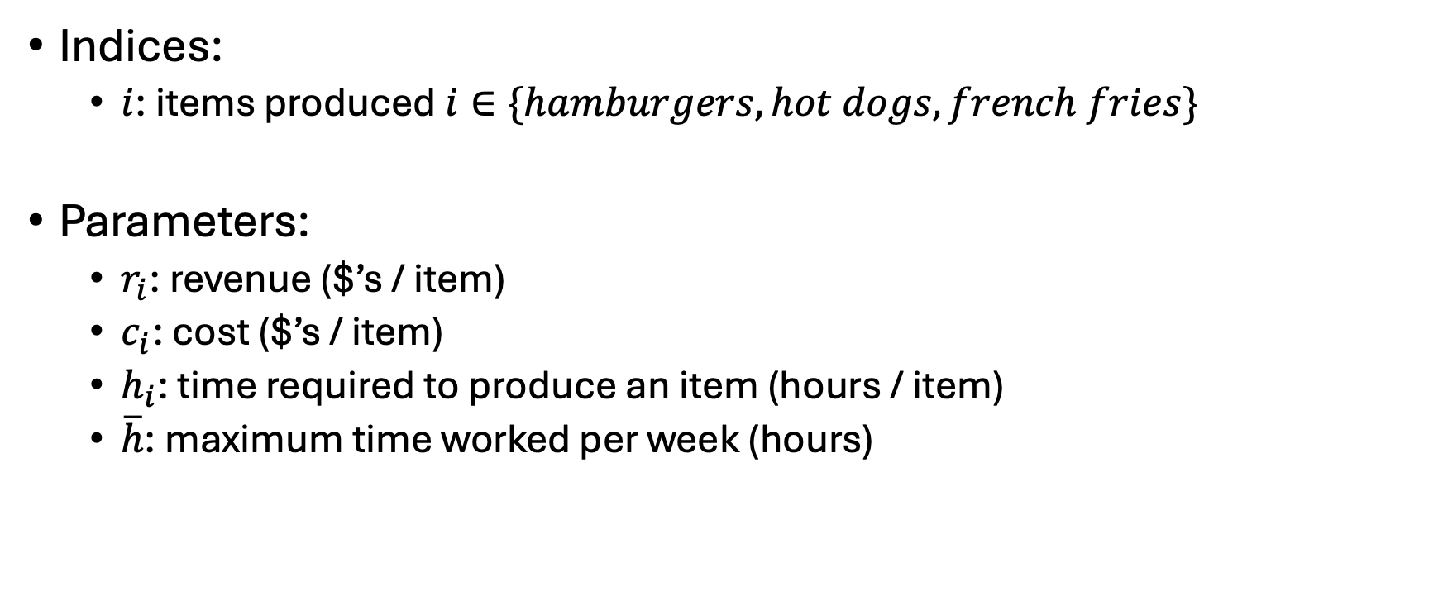
Ripley’s restaurant
Indices:
$i$: items produced $i∈\{hamburgers, hot dogs, french fries\}$
Parameters:
$r_{i}$: revenue ($’s / item)
$c_{i}$: cost ($’s / item)
$h_{i}$: time required to produce an item (hours / item)
$\overline{h}$: maximum time worked per week (hours)
Item | Revenue | Cost | Hours
Hamburger | 1.5 | 0.75 | 0.5
Hot dog | 0.75 | 0.1 | 0.2
French fries | 0.25 | 0.05 | 0.1

Slide 13
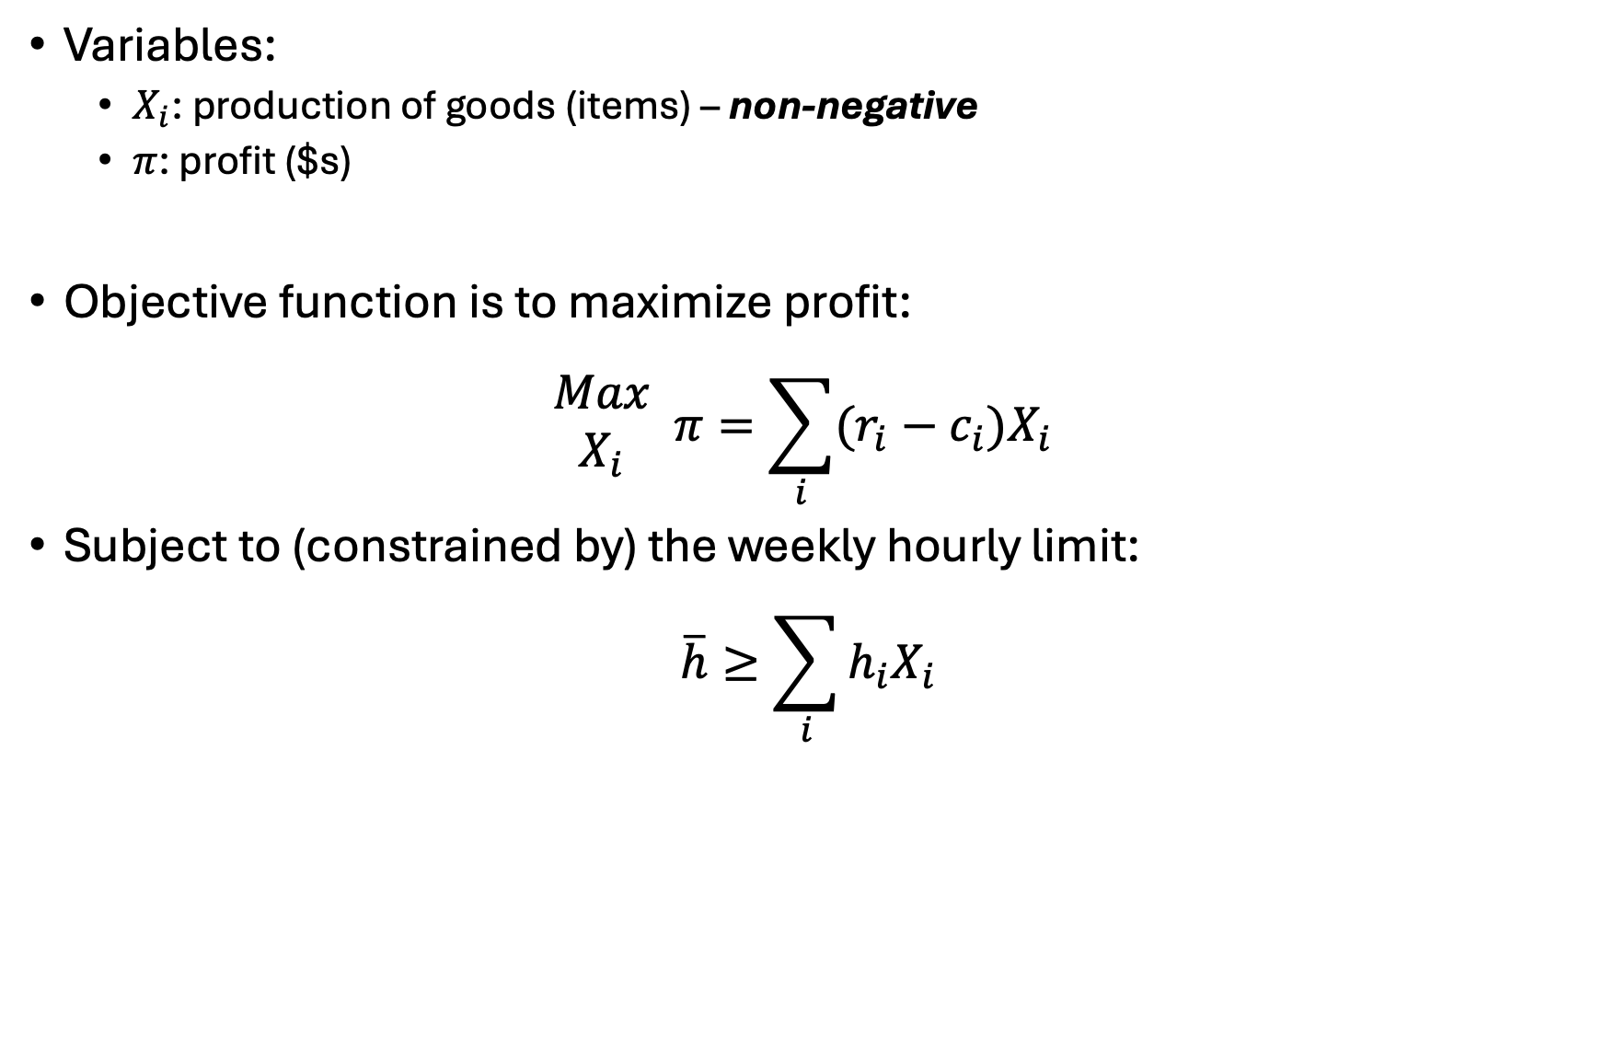
Ripley’s restaurant
Variables:
$X_{i}$: production of goods (items) – non-negative
$π$: profit ($s)
Objective function is to maximize profit:
$$\begin{matrix}Max \\ X_{i}\end{matrix} π=\sum_{i}{(r_{i}−c_{i})X_{i}}$$
Subject to (constrained by) the weekly hourly limit:
$$\overline{h}≥\sum_{i}{h_{i}X_{i}}$$

Slide 14
Ripley’s restaurant
Let’s code this up in GAMS…

Slide 15
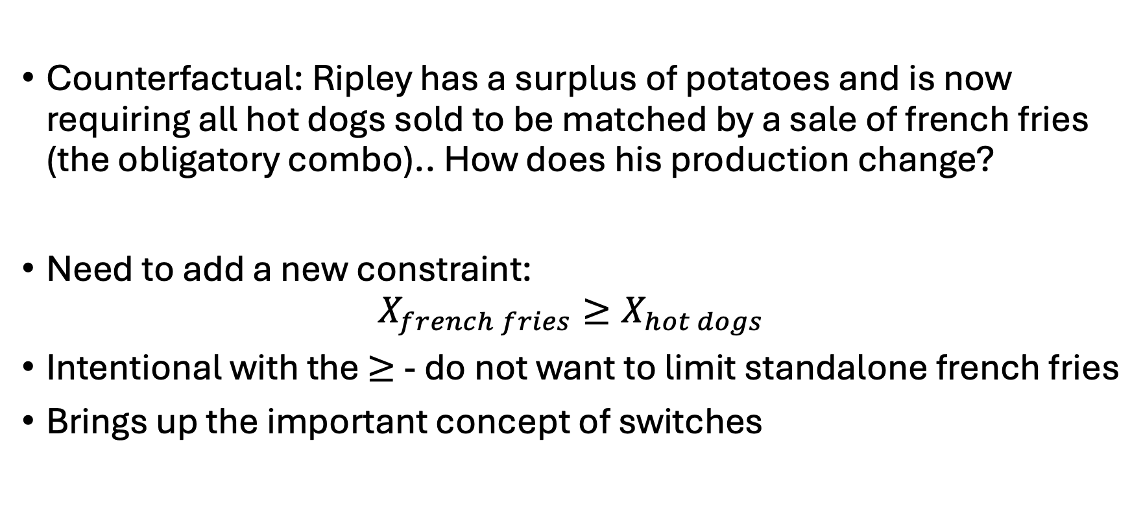
Ripley’s restaurant
Counterfactual: Ripley has a surplus of potatoes and is now requiring all hot dogs sold to be matched by a sale of french fries (the obligatory combo).. How does his production change?
Need to add a new constraint:
$$X_{french fries}≥X_{hot dogs}$$
Intentional with the $≥$ - do not want to limit standalone french fries
Brings up the important concept of switches

Slide 16
Globals (‘global arguments’)
Basically: passing information in from the terminal
Why? Don’t want to manually run, change things, run again, …
Prone to human error
Automation saves your sanity
Scripting helps for reproduction (of results)
Here – going to run this example twice:
Once with the switch enabled
.. then again without the switch enabled
Both times passing the argument from the command prompt

Slide 17
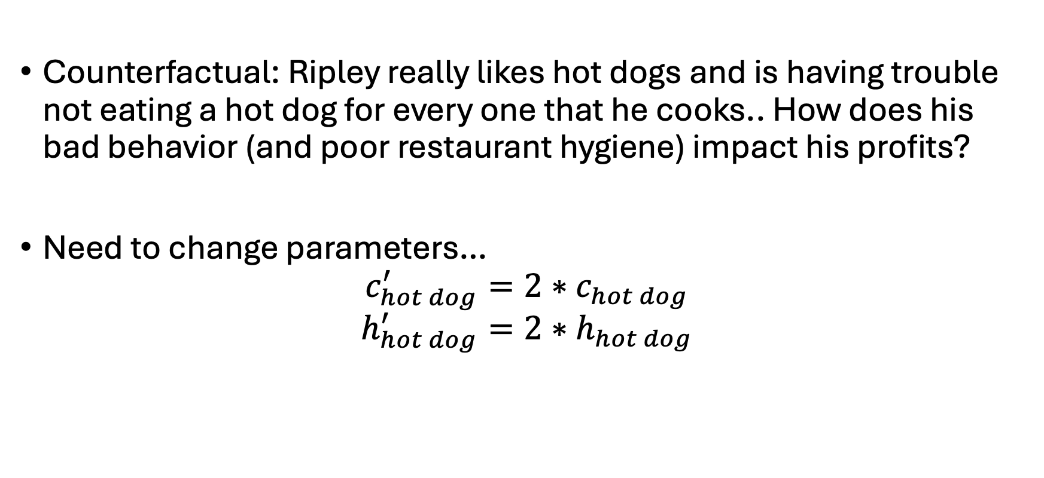
Ripley’s restaurant
Counterfactual: Ripley really likes hot dogs and is having trouble not eating a hot dog for every one that he cooks.. How does his bad behavior (and poor restaurant hygiene) impact his profits?
Need to change parameters…
$$c_{hot dog}^{′}=2∗c_{hot dog}$$
$$h_{hot dog}^{′}=2∗h_{hot dog}$$

Slide 18
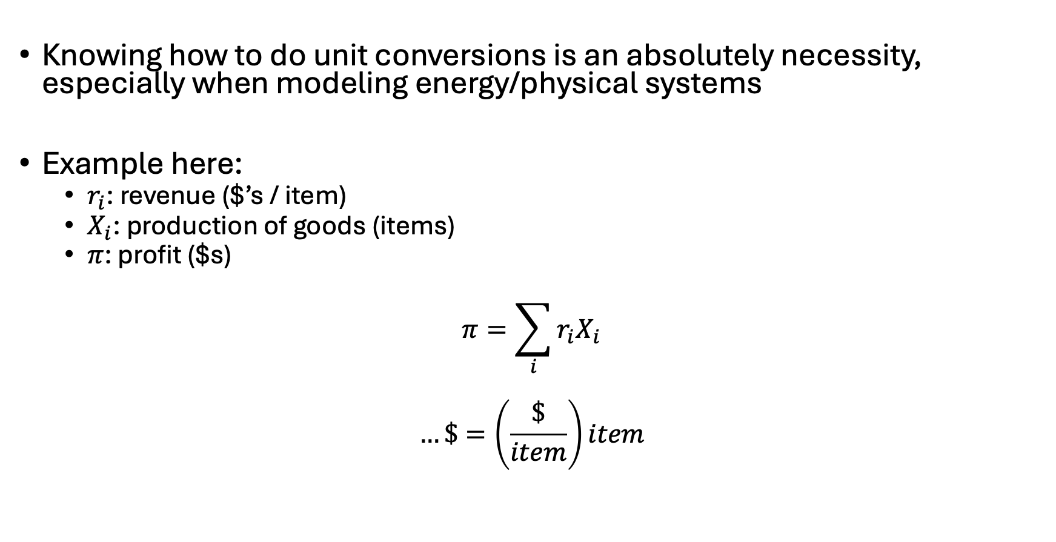
Notes on unit conversions
Knowing how to do unit conversions is an absolutely necessity, especially when modeling energy/physical systems
Example here:
$r_{i}$: revenue ($’s / item)
$X_{i}$: production of goods (items)
$π$: profit ($s)
$$π=\sum_{i}{{r_{i}X}_{i}}$$
$$…\$=\left(\frac{\$}{item}\right)item$$

Slide 19
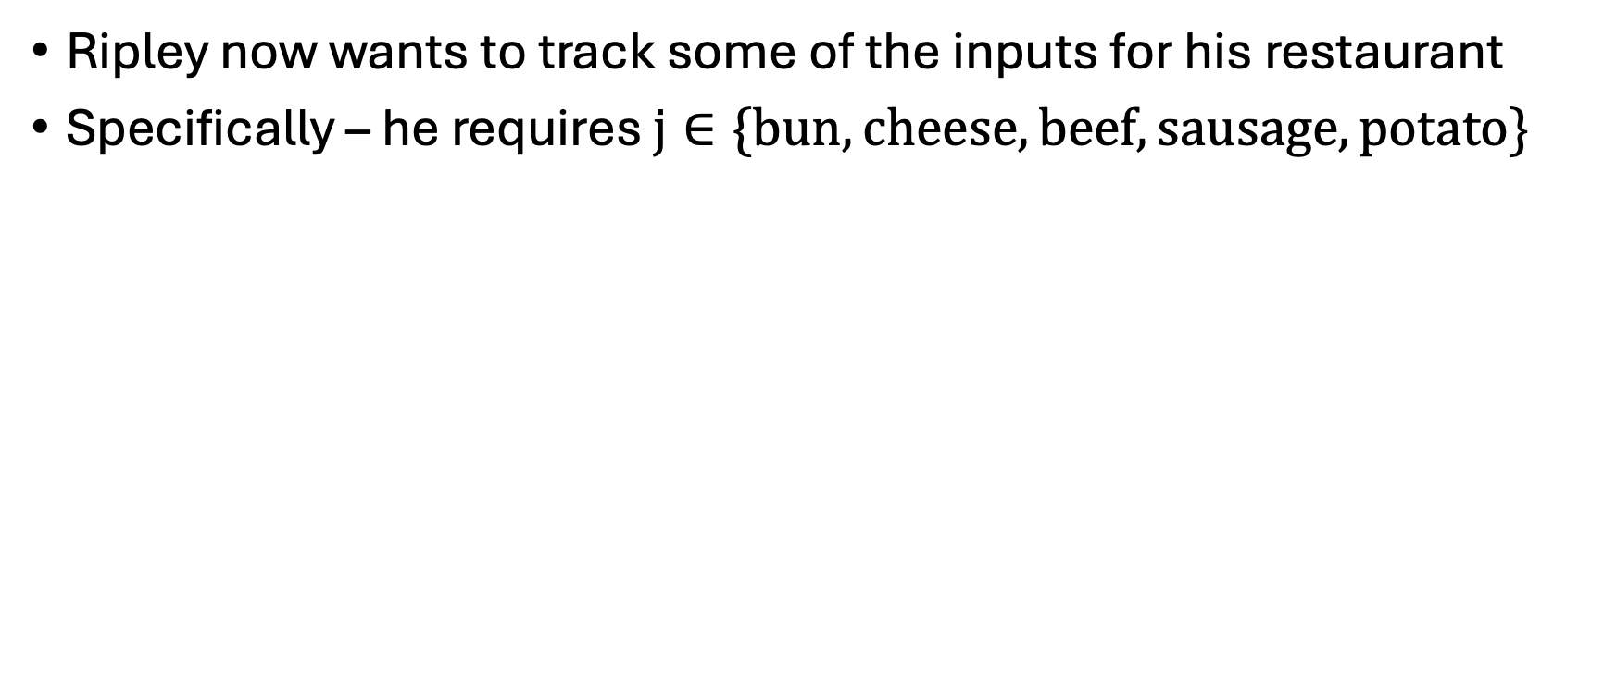
Ripley’s equipment requirements
Ripley now wants to track some of the inputs for his restaurant
Specifically – he requires $j∈\{bun,cheese,beef,sausage,potato\}$
Input | Hot Dog | Hamburger | French Fries
Bun | 1 | 1
Cheese |  | 1
Beef |  | 1
Sausage | 1
Potato |  |  | 2

Slide 20
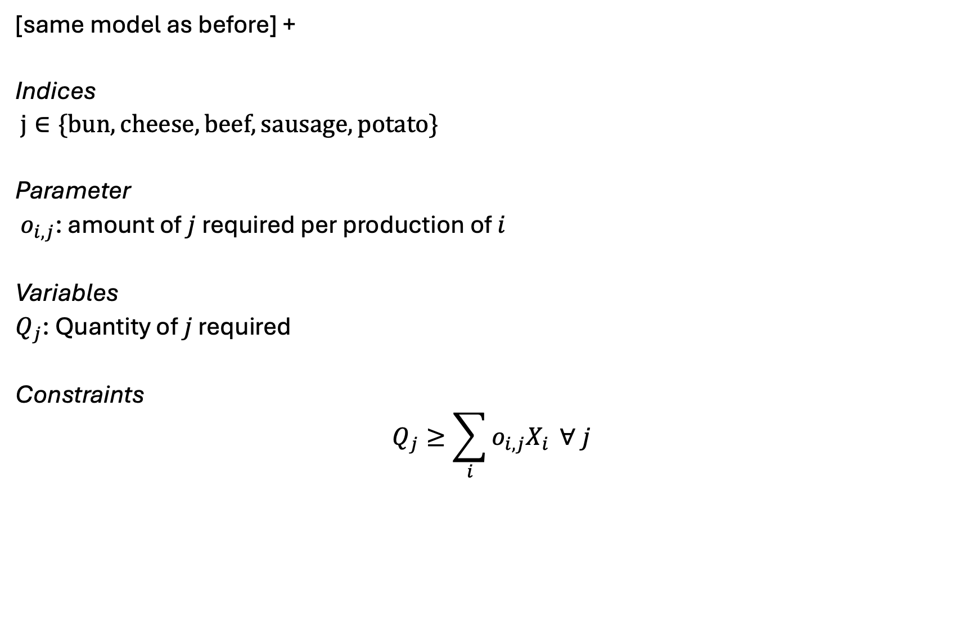
Extension to Ripley’s restaurant
[same model as before] +
Indices
$j∈\{bun,cheese,beef,sausage,potato\}$
Parameter
$o_{i,j}$: amount of $j$ required per production of $i$
Variables
$Q_{j}$: Quantity of $j$ required
Constraints
$$Q_{j}≥\sum_{i}{o_{i,j}X_{i}} ∀ j$$

Slide 21
Sparse matrix construction [I]
Solvers (CPLEX/Gurobi) are pretty good at eliminating irrelevant combinations of indices – e.g. Ripley doesn’t need to use a potato for his hot dog
-but- this only goes so far and, when you get to big models, the pre-solve step is unreliable

Slide 22
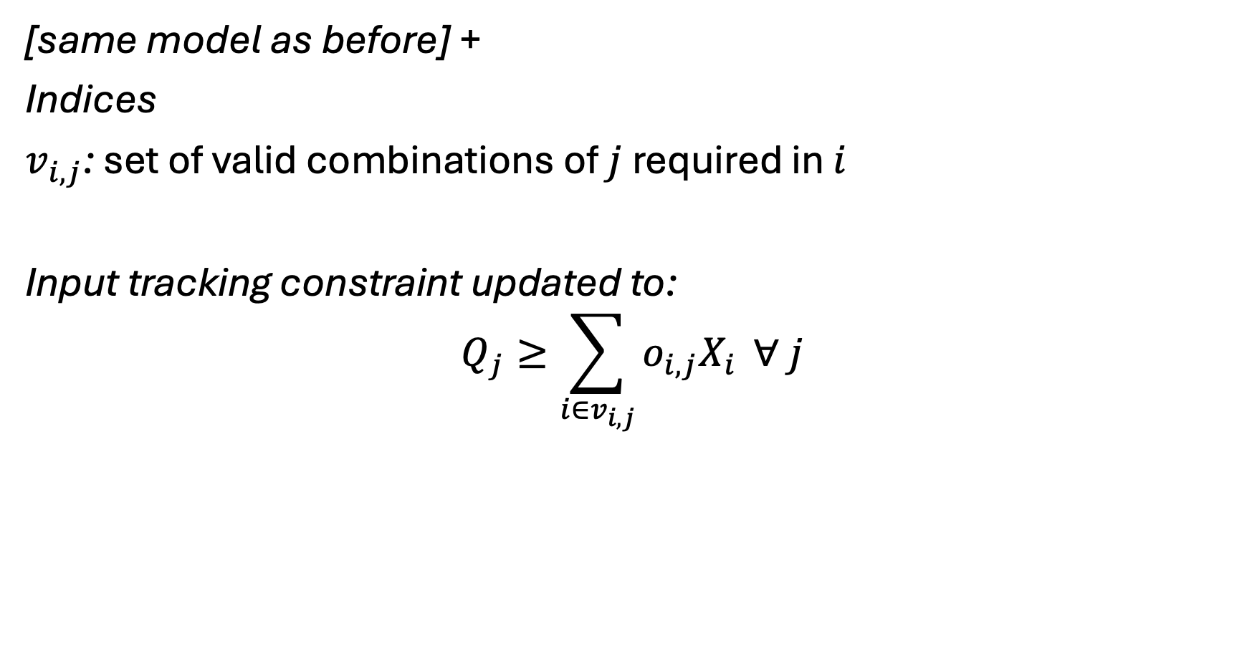
Sparse matrix construction [II]
[same model as before] +
Indices
$v_{i,j}$: set of valid combinations of $j$ required in $i$
Input tracking constraint updated to:
$$Q_{j}≥\sum_{i∈v_{i,j}}{o_{i,j}X_{i}} ∀ j$$

Slide 23
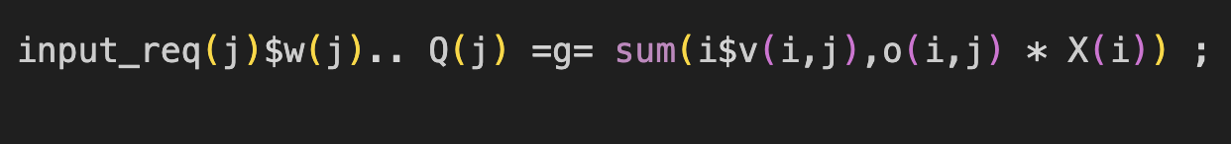
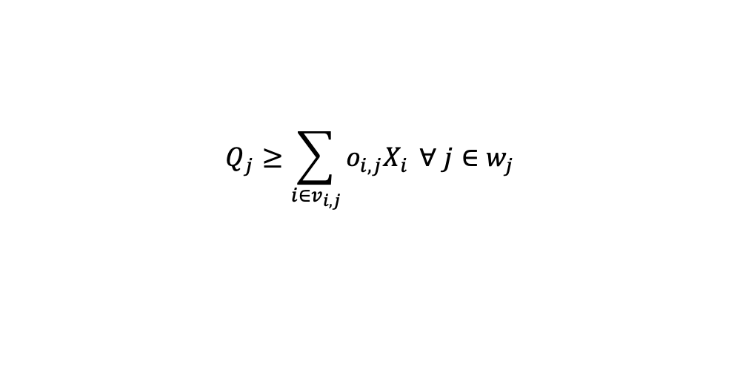
Translating math to GAMS
$$Q_{j}≥\sum_{i∈v_{i,j}}{o_{i,j}X_{i}} ∀ j∈w_{j}$$

Slide 24
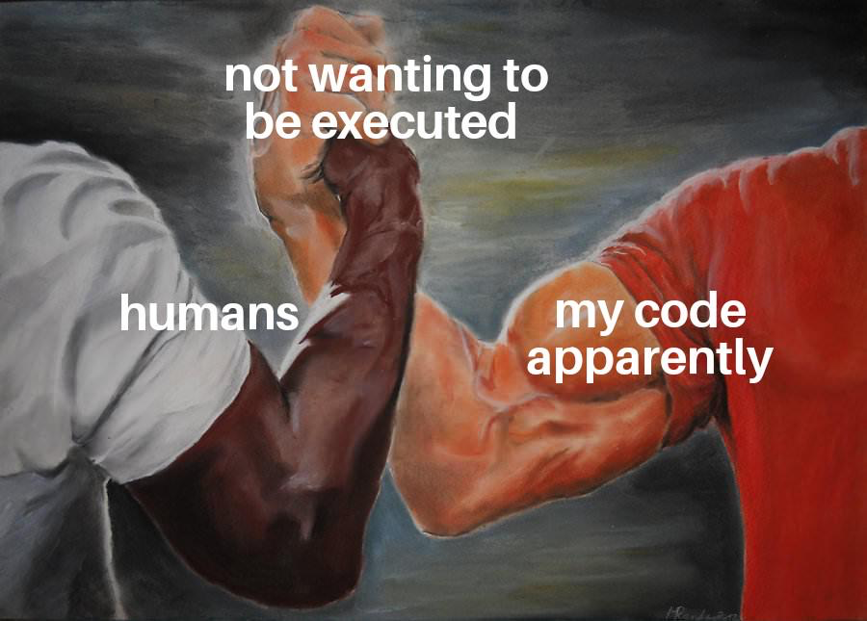
Common errors in GAMS

Slide 25

Example 2: Ursula’s Utility
Ursula love’s eating pizza and beer. She is at Woody’s and is trying to decide what combination would maximize her utility/happiness. She has $20 in her pocket and forgot her wallet (luckily she’s a regular and they don’t ID her). Each piece of pizza costs $2 and gives her 2 utils of satisfaction while each beer costs $4 and gives her 5 utils of satisfaction. What is Ursula’s utility-maximizing set of consumption choices?
Also – what major utility assumption are we violating?

Slide 26
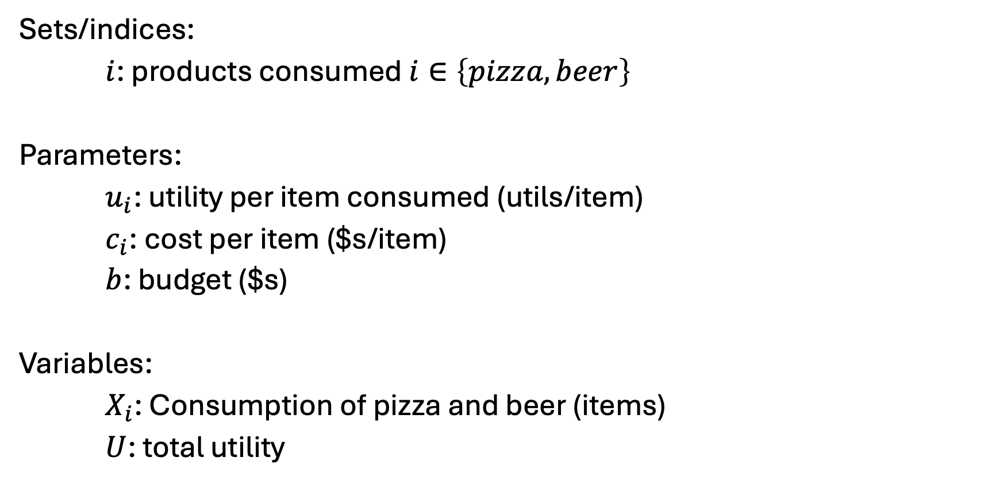
Ursula’s Utility [I] – Sets, parameters, variables
Sets/indices:
$i$: products consumed $i∈\left\{pizza, beer\right\}$
Parameters:
$u_{i}$: utility per item consumed (utils/item)
$c_{i}$: cost per item ($s/item)
$b$: budget ($s)
Variables:
$X_{i}$: Consumption of pizza and beer (items)
$U$: total utility

Slide 27
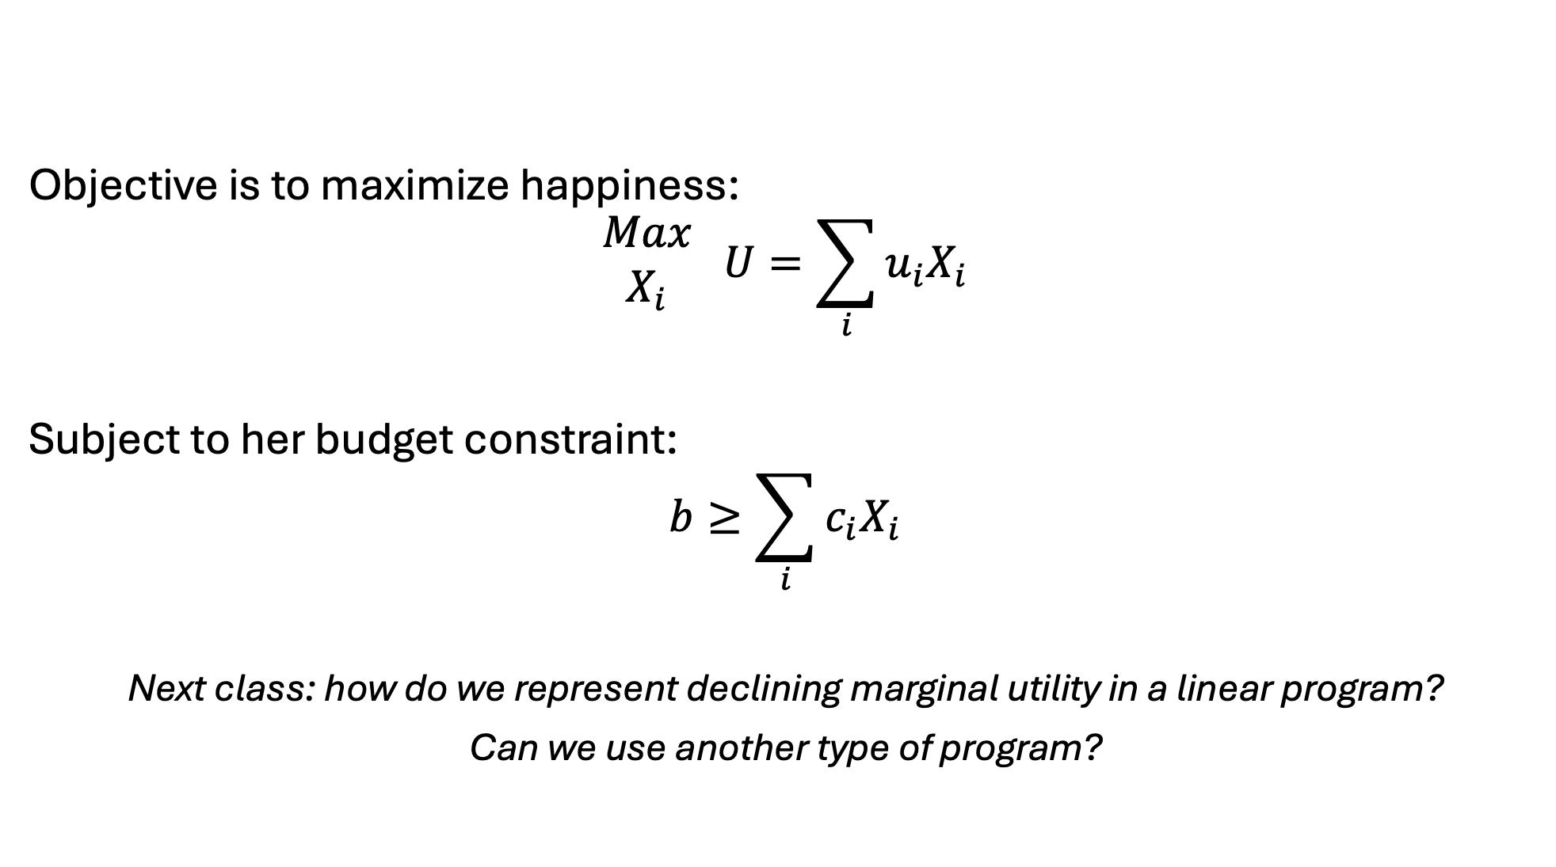
Ursula’s Utility [II] – Objective and constraints
Objective is to maximize happiness:
$$\begin{matrix}Max \\ X_{i}\end{matrix} U=\sum_{i}{u_{i}X_{i}}$$
Subject to her budget constraint:
$$b≥\sum_{i}{c_{i}X_{i}}$$
Next class: how do we represent declining marginal utility in a linear program?
Can we use another type of program?

Slide 28
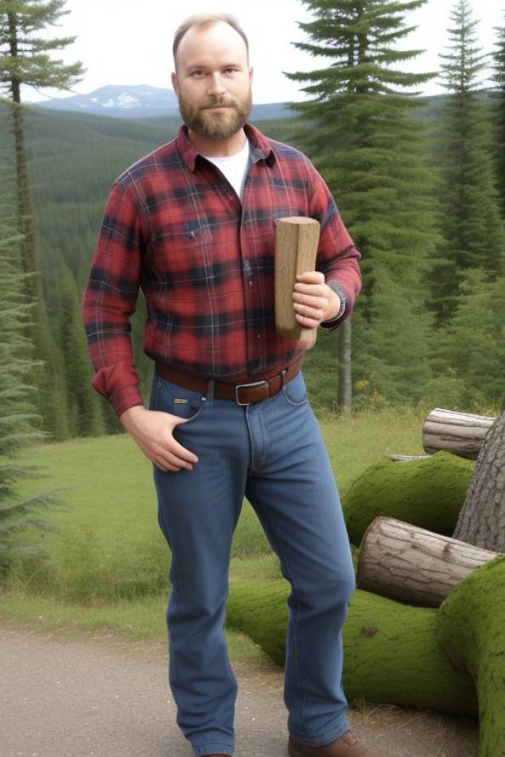
Example 3: Franz Forestry
Franz owns land that produces lumber. Franz makes $100 net profit for every tree cut down. There is an initial stand of 100 trees and the trees grow at 1%* per year. Franz has a discount rate of 2%*. What is Franz profit-maximizing harvesting behavior?
*: Varied in counterfactuals

Slide 29
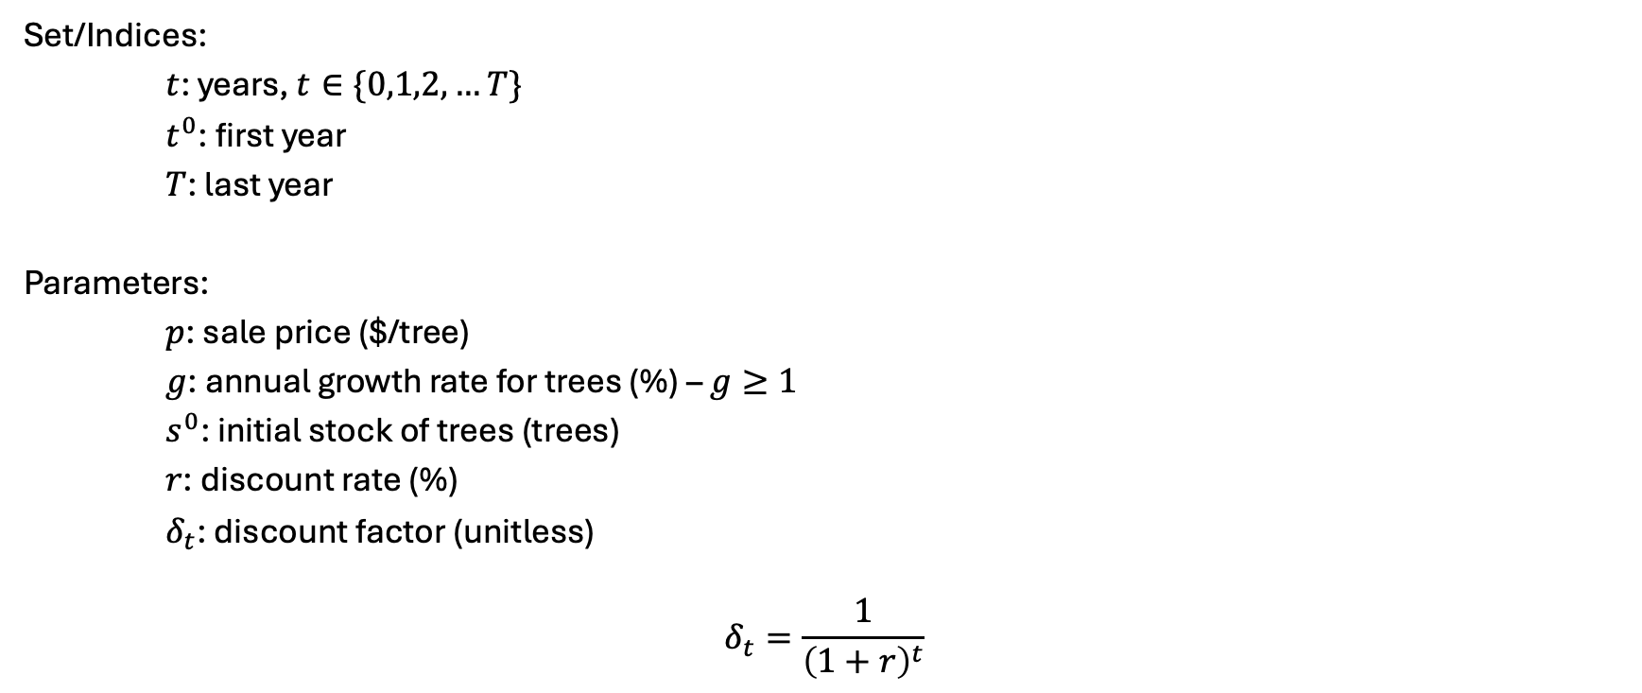
Franz Forestry [I] – sets and parameters
Set/Indices:
$t$: years, $t∈\{0,1,2,…T\}$
$t^{0}$: first year
$T$: last year
Parameters:
$p$: sale price ($/tree)
$g$: annual growth rate for trees (%) – $g≥1$
$s^{0}$: initial stock of trees (trees)
$r$: discount rate (%)
$δ_{t}$: discount factor (unitless)
$$δ_{t}=\frac{1}{{\left(1+r\right)}^{t}}$$

Slide 30
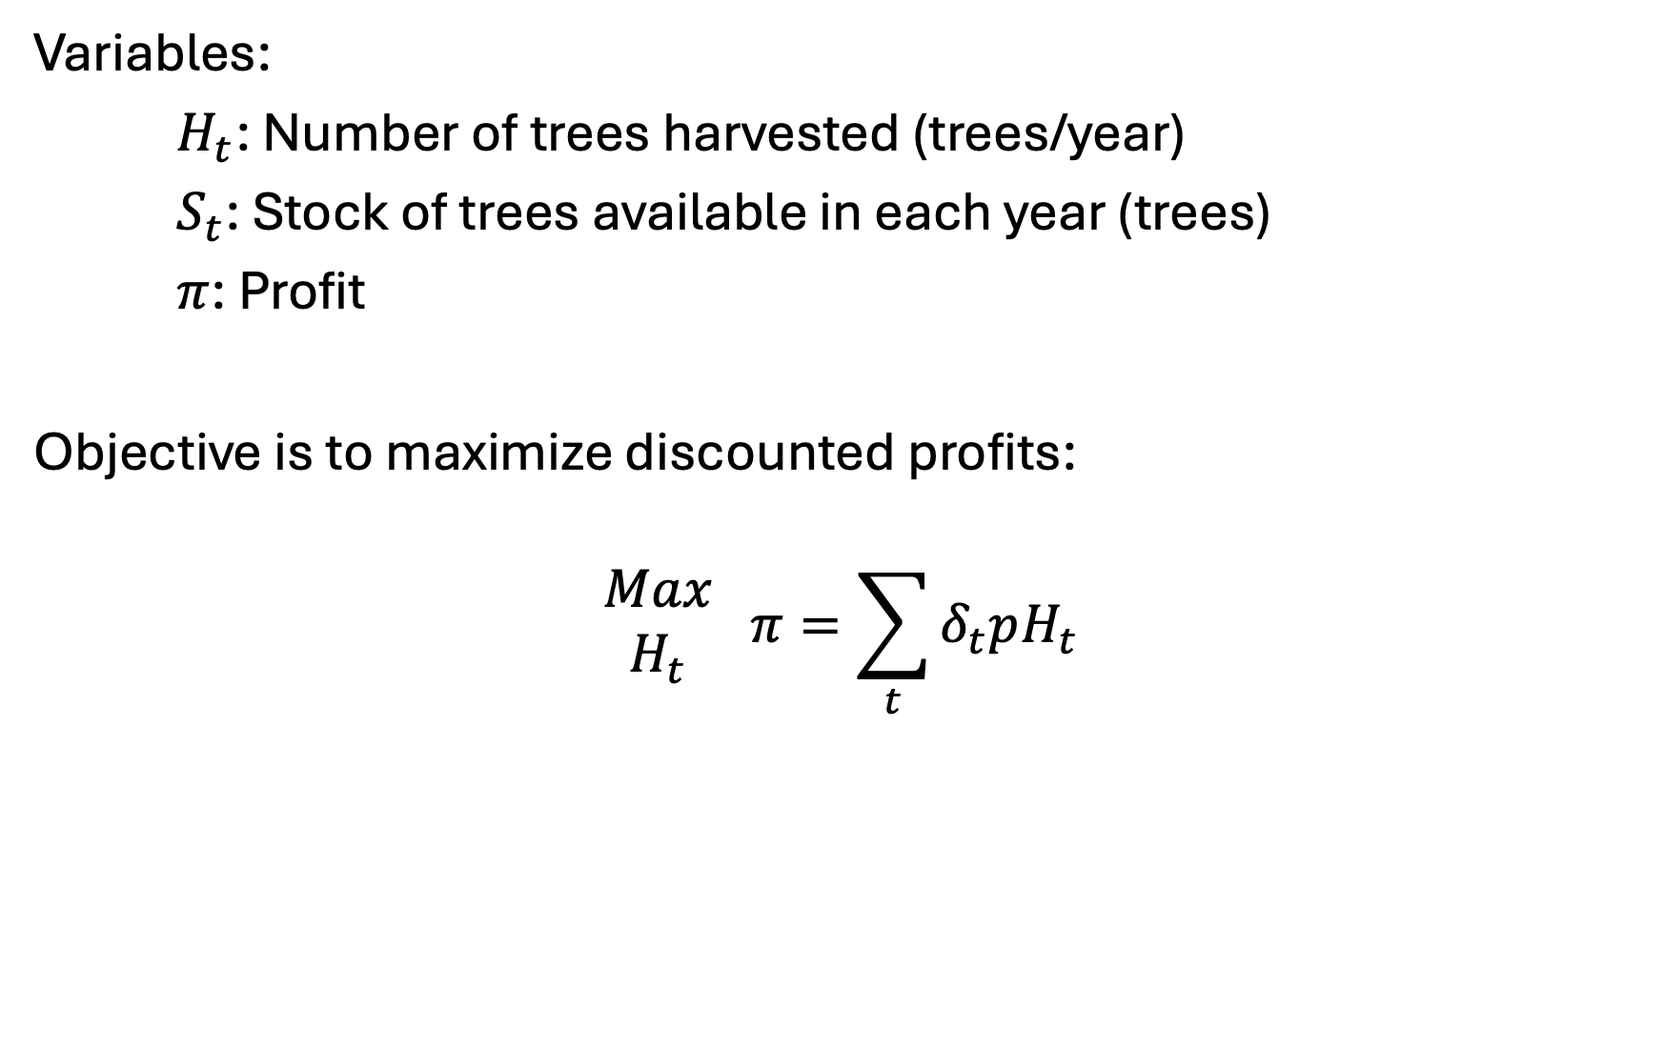
Franz Forestry [II] – variables and objective
Variables:
$H_{t}$: Number of trees harvested (trees/year)
$S_{t}$: Stock of trees available in each year (trees)
$π$: Profit
Objective is to maximize discounted profits:
$$\begin{matrix}Max \\ H_{t}\end{matrix} π=\sum_{t}{δ_{t}pH_{t}}$$

Slide 31
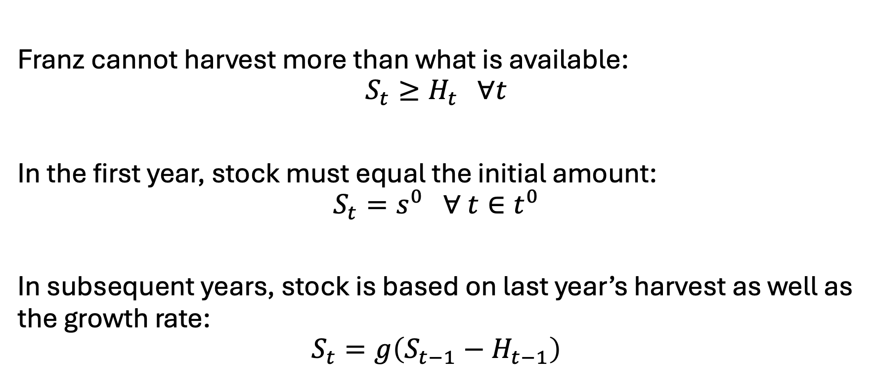
Franz Forestry [III] - constraints
Franz cannot harvest more than what is available:
$$S_{t}≥H_{t} ∀t$$
In the first year, stock must equal the initial amount:
$$S_{t}=s^{0} ∀ t∈t^{0}$$
In subsequent years, stock is based on last year’s harvest as well as the growth rate:
$$S_{t}=g\left(S_{t−1}−H_{t−1}\right)$$

Slide 32
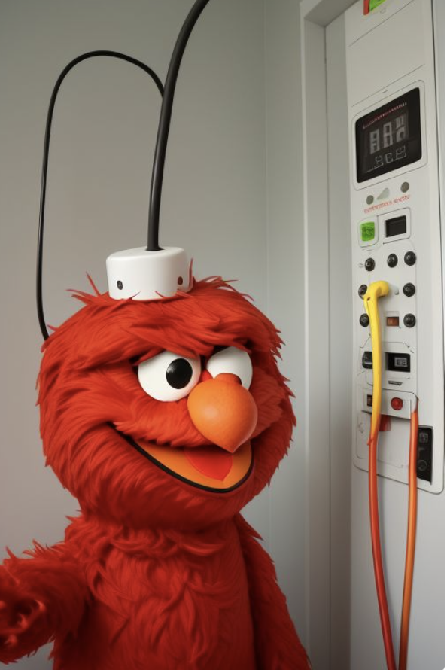
Example 4: Elmo’s Electricity
Elmo runs a small electricity utility. He has three electricity facilities: coal, gas, and wind. Each technology has its own cost and capacity. He must meet the hourly demand of his small town. What is Elmo’s cost-minimizing set of operational decisions?

Slide 33
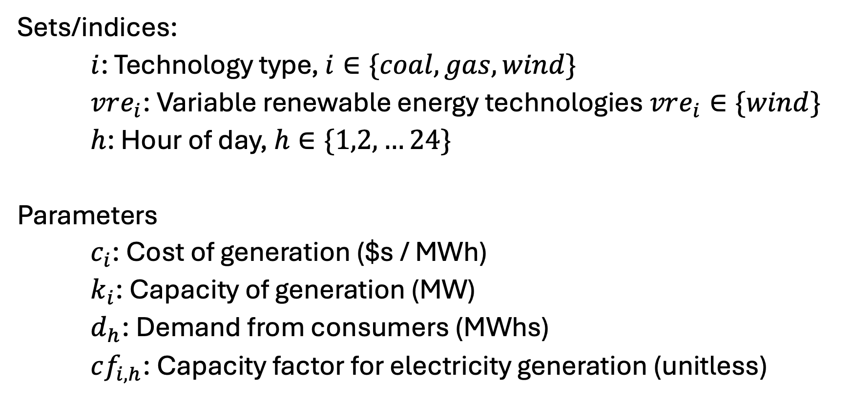
Elmo’s Electricity [I] – Sets and parameters
Sets/indices:
$i$: Technology type, $i∈\{coal, gas, wind\}$
$vre_{i}$: Variable renewable energy technologies $vre_{i}∈\{wind\}$
$h$: Hour of day, $h∈\{1,2,…24\}$
Parameters
$c_{i}$: Cost of generation ($s / MWh)
$k_{i}$: Capacity of generation (MW)
$d_{h}$: Demand from consumers (MWhs)
$cf_{i,h}$: Capacity factor for electricity generation (unitless)

Slide 34
Elmo’s electricity [II] - data
See spreadsheet - EBGN645_Data_Day3.xlsx

Slide 35
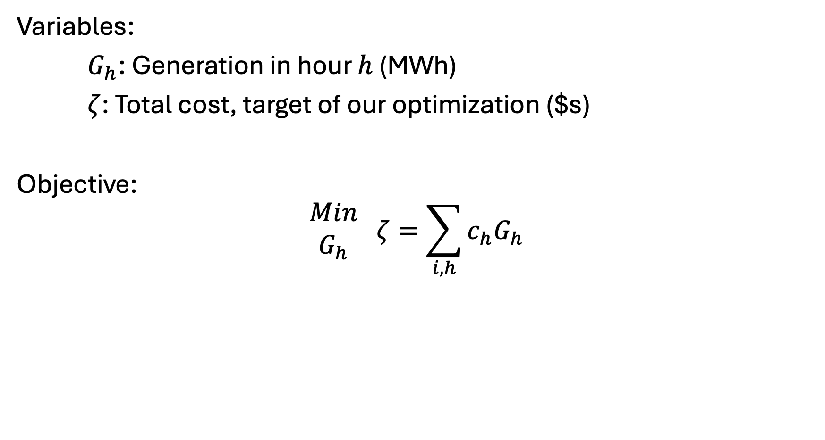
Elmo’s Electricity [III] – Variables and objective
Variables:
$G_{h}$: Generation in hour $h$ (MWh)
$ζ$: Total cost, target of our optimization ($s)
Objective:
$$\begin{matrix}Min \\ G_{h}\end{matrix} ζ=\sum_{i,h}{c_{h}G_{h}}$$

Slide 36
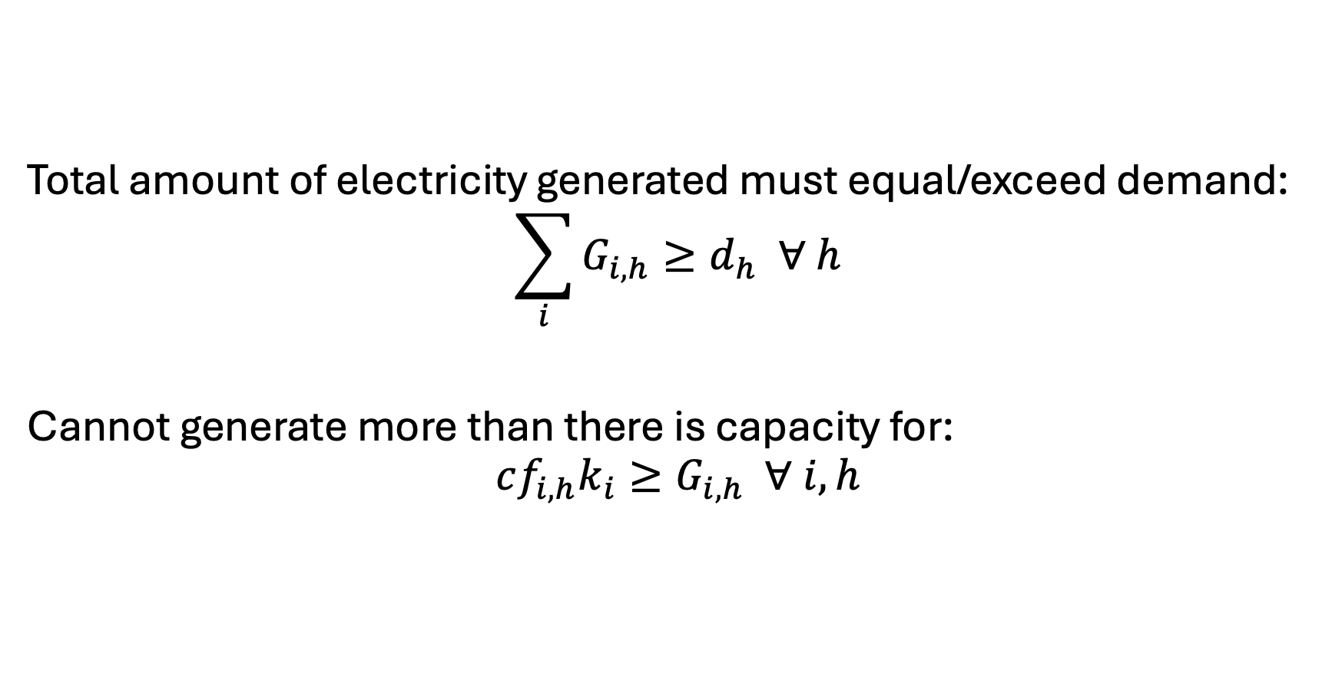
Elmo’s Electricity [IV] - Constraints
Total amount of electricity generated must equal/exceed demand:
$$\sum_{i}{G_{i,h}}≥d_{h} ∀ h$$
Cannot generate more than there is capacity for:
$$cf_{i,h}k_{i}≥G_{i,h} ∀ i,h$$

